Slide 1
AP sigma environment setup SOP

Slide 2
Outline
Introduction
Device preparation
Network route configuration
Environment setup steps

Slide 3
Introduction
This SOP is designed for AP sigma testing, including following programs:
WMMPS
TGn
PMF
TGac
WPA2 security improvement

Slide 4
Device preparation
One notebook(CA notebook)
With Windows OS and connect with UCC and the test device
One test phone(APUT)
Connecting to the notebook with USB cable

Slide 5
Network route configuration
Data network switch
(192.165.x.x)
Control network switch
(192.168.x.x)
CA
eth0
UCC
192.165.100.10
192.168.250.99
eth1
bridge
rndis
usb tethering
APUT
rndis
Testbed APs
Control network
192.165.100.99
Data network
bridge
Testbed STAs
USB cable
Wireless network
ap0

Slide 6

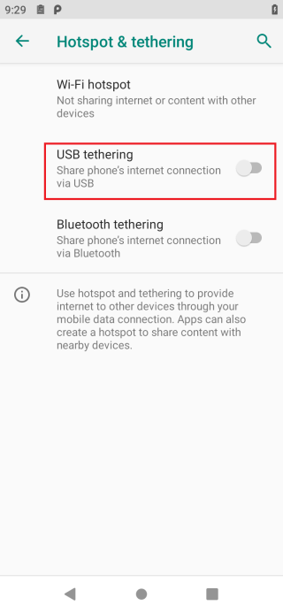
Environment setup steps (1/4)
Prepare one phone as DUT (APUT) , and one notebook as control agent notebook (CA). Connect APUT to CA notebook with USB cable.
Fixed Wi-Fi mac address on APUT and also update the Mac address in init file
Use cables to connect CA notebook to control network switch (192.168.x.x) & data network switch (192.165.x.x) separately
Turn off Wi-Fi & hotspot from Settings on APUT
Turn on USB tethering from Settings on APUT

Slide 7
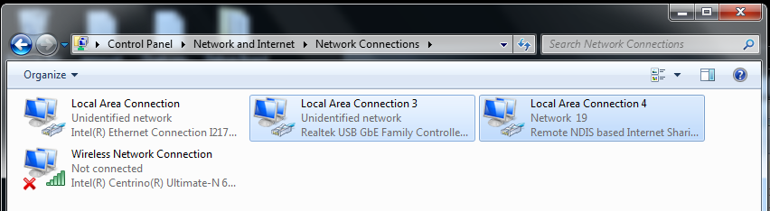
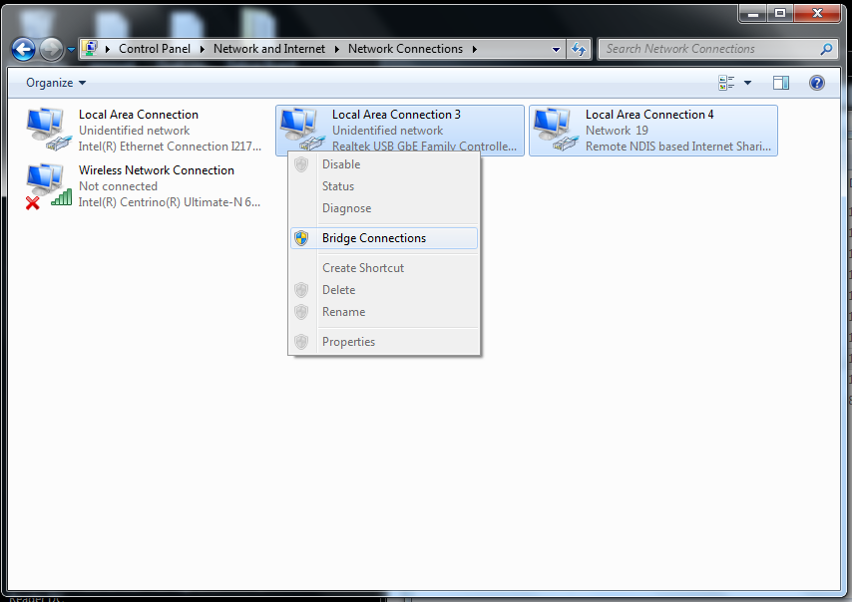
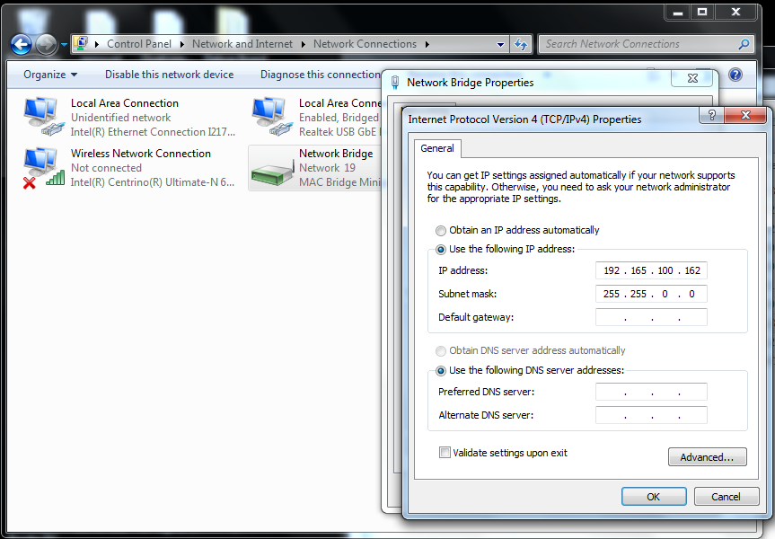
Environment setup steps (2/4)
Create a bridge between data network and USB network on CA notebook and set a available IP & net mask for this bridge network, eg. IP: 192.165.100.162, netmask: 255.255.0.0

Slide 8
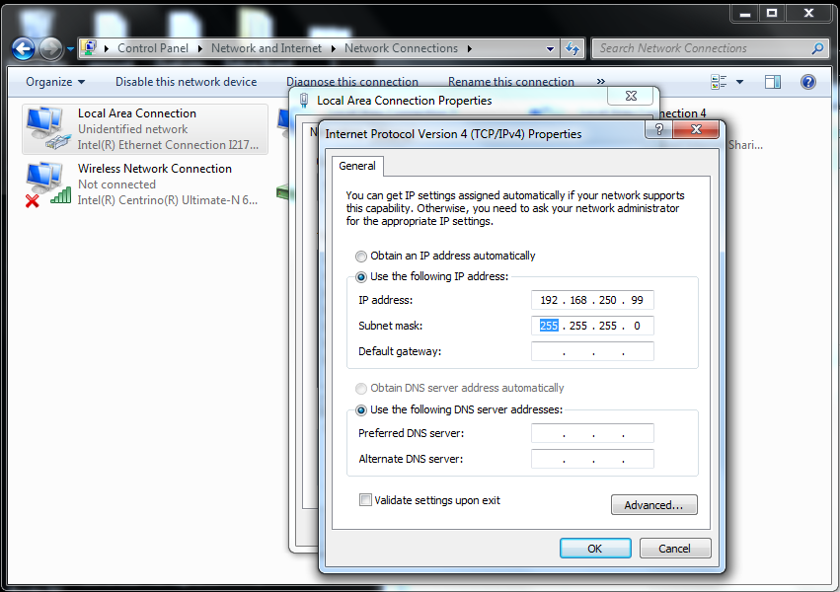

Environment setup steps (3/4)
Setup APUT’s & PCE’s control network, eg. IP: 192.168.250.99, netmask: 255.255.255.0
Set IP address of control network (192.168.x.x) on CA notebook.
Update init file
Update ENV_SETUP.bat in AP sigma tool
## PC Endpoint (WFA Traffic generator console)

Slide 9



Environment setup steps (4/4)
Setup APUT’s & PCE’s wireless network, eg. IP: 192.165.100.99, netmask: 255.255.0.0
Update init file
Update ENV_SETUP.bat in AP sigma tool
## PC Endpoint (WFA Traffic generator console)

Slide 10
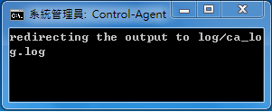
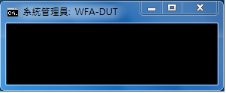
Install & run sigma tool
Execute the install script in AP sigma tool, i.e. STEP_01_install_sigma.bat
Execute STEP_02_start_sigma.bat to start AP sigma tool

